Slide 1
Database
MySQL Database
Session 3
Presented by: Ma Myint Myint
12.12.2010

Slide 2
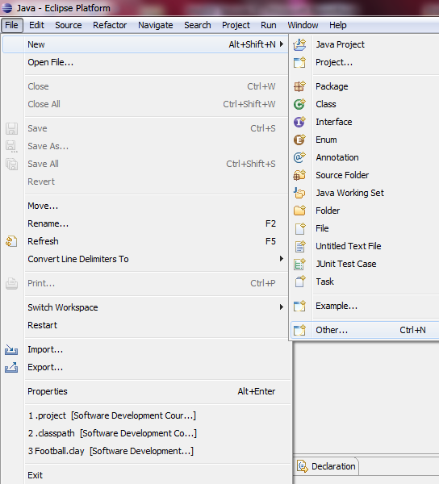
Create New Database Diagram
File/New/Other,
Or
right_click (on
the project name)
New/Other

Slide 3
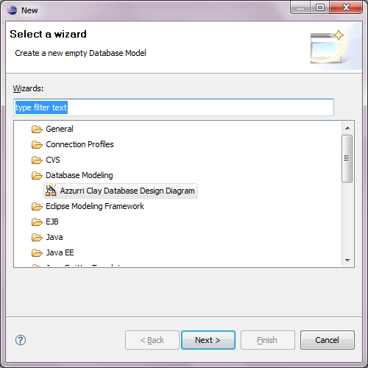
Create New Database Diagram
Then, select Database Modeling Azzurri Clay Database Design Diagram

Slide 4
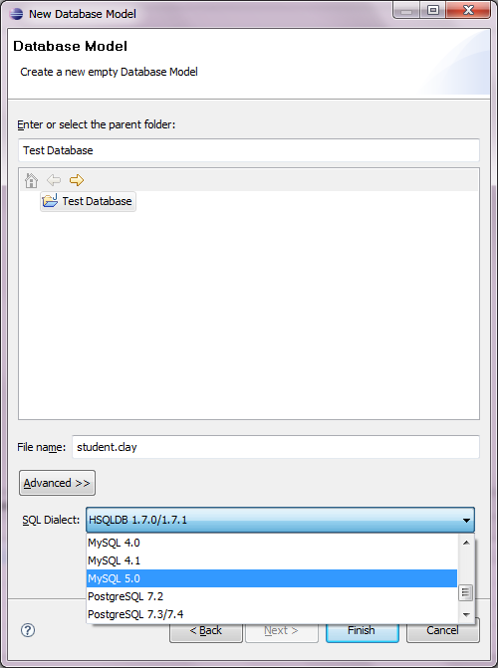
Create New Database Diagram
Give :the file name (eg: student.clay)
Select : SQL Diafect as Postgre SQL 7.3/7.4 or
MySQL 5.0 and click Finish

Slide 5
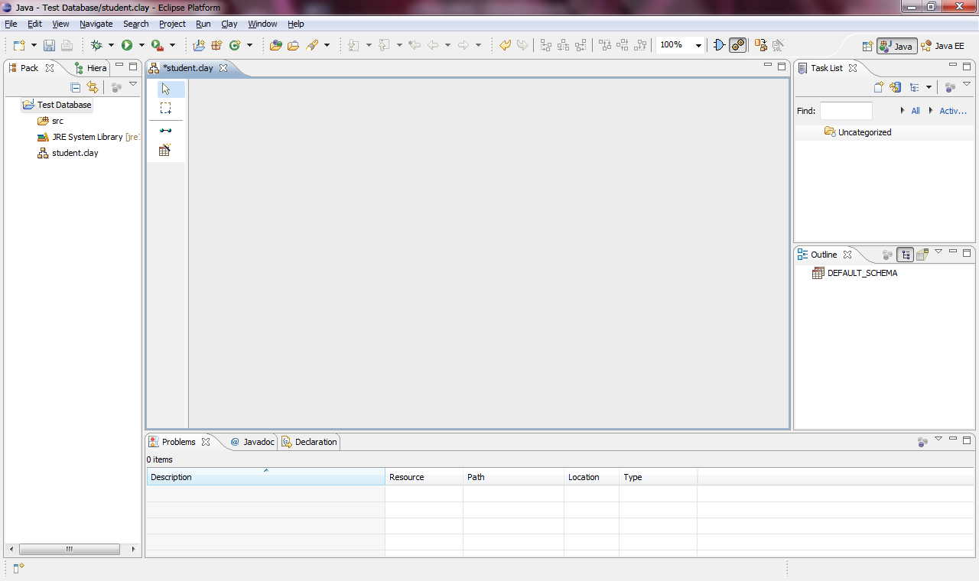
To draw the ER_Diagram

Slide 6
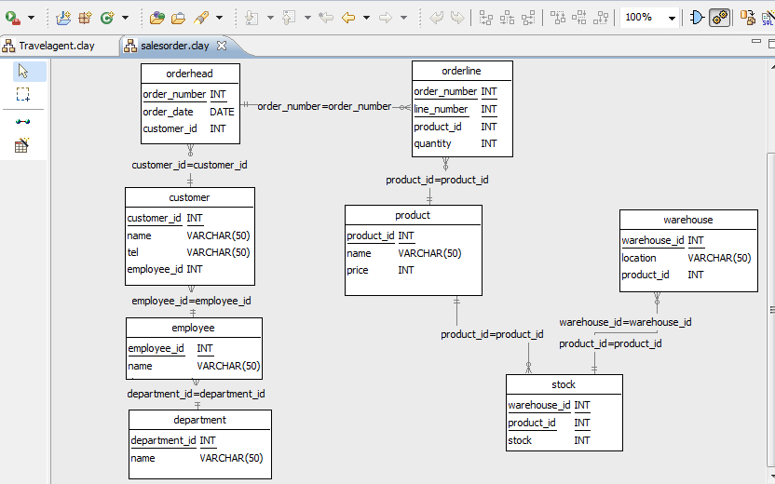
draw the ER_Diagram

Slide 7
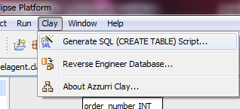
To Generate MySQL Code
Double_click to the project name(eg: salesorder.clay)
click the Generate SQL(CREATE TABLE) on the Clay menu

Slide 8
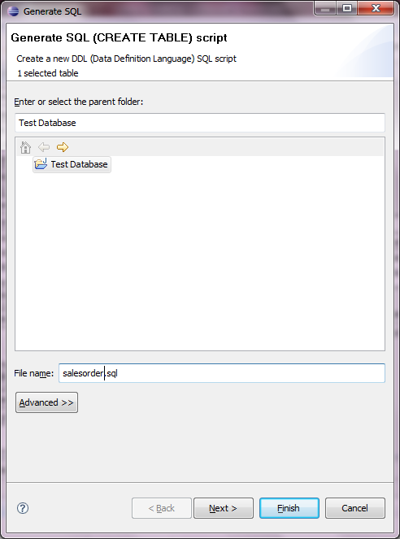
To Generate MySQL Code
Then, double_click the database name
Give the file name
Click finish

Slide 9
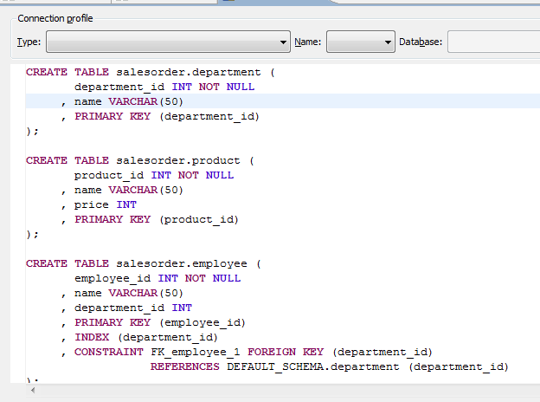
To Generate MySQL Code
Replace the schema name to all the DEFAULT_SCHEMA

Slide 10
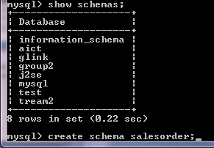
To Insert the Code to the MySQL
Mysql> create schema salesorder;
Use salesorder;

Slide 11
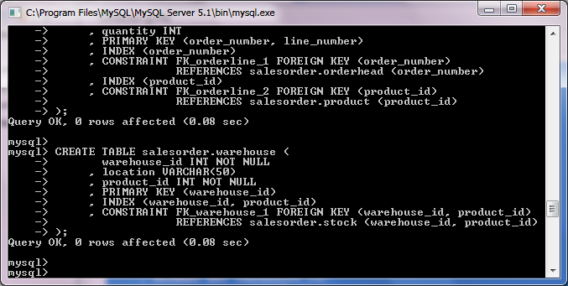
To Create the Table to the MySQL
Copy the sql code and paste to the MySQL Database

Slide 12
Thank you!!!

